Slide 1

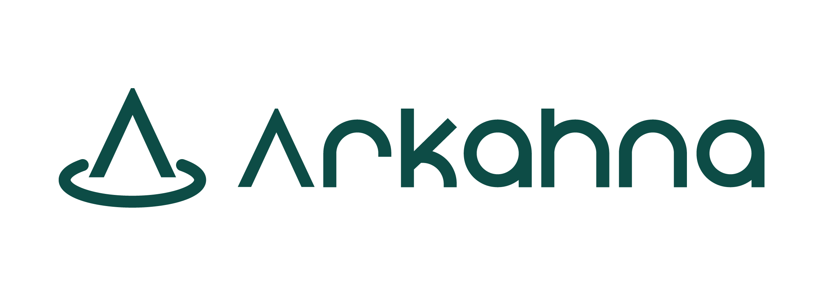

What does cloud native security look like?
JakeGinnivan
Notes:
This talk is really about 3 things
Why security is important, and what are your risks
What are the tools in your toolbox
A safer future

Slide 2
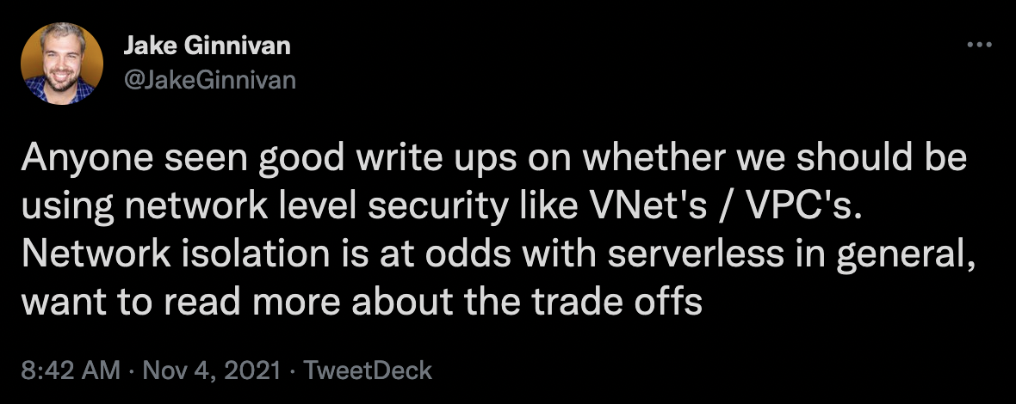
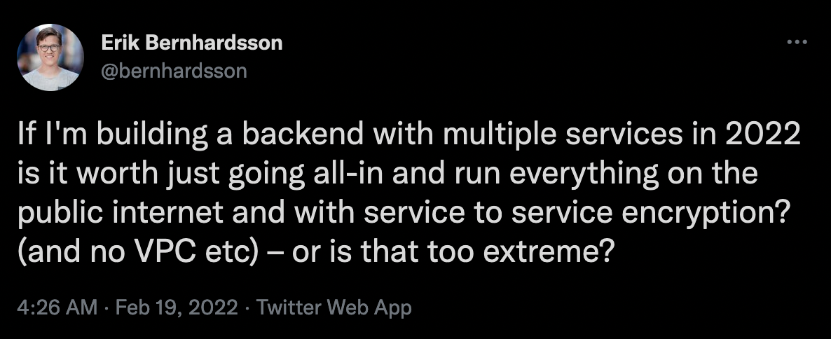
Notes:
My goal around this talk is to re-evaluate my understanding of the ‘best practices’ I use, why I use them..
It was triggered by the Azure Functions limitation of no vnet / private endpoint support when using the ‘consumption’ tier. Talk about serverless

Slide 3
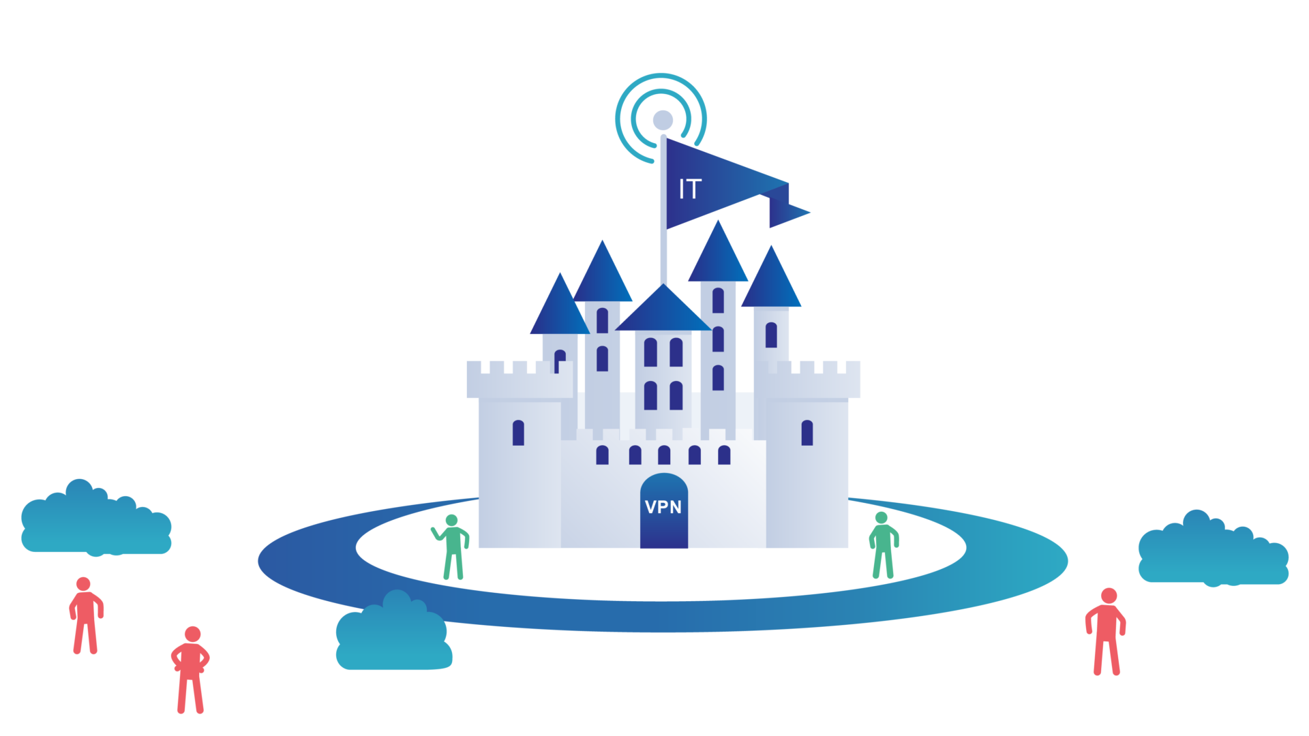
Notes:
Defense in depth is an important strategy, but it is less effective in the modern world
But so many other ways in, and we have more effective controls now to use in addition to network isolation when appropriate

Slide 4

Serverless
Notes:
Quick detour to talk about serverless, and what I think it is
(while it’s not being used, it doesn’t cost you anything).

Slide 5

Security = less risk
Notes:
Let’s start with what does everyone one see security as?
Risk of
Business continuity
Risk of data loss
Risk of brand damage
Risk of extorsion
Investments in security help guard you against these risks. And better security costs money.

Slide 6

So, what are my risks?

Slide 7
Business continuity
Data loss
Brand/reputation damage
Extortion

Slide 8

Threats to consider..

Slide 9
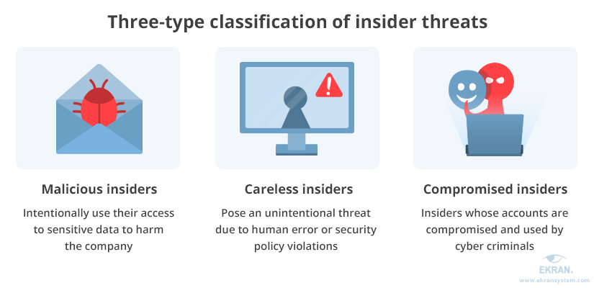
Insider threats?
Notes:
https://www.proofpoint.com/sites/default/files/infographics/pfpt-us-ig-insider-threat-infographic.pdf

Slide 10

Shadow IT & the rise of SaaS
Importance of making things easy for staff
How to design when you can’t create a network perimiter

Slide 11

Supply chain target the developers
GitLab Development Kit driveby
NPM / NuGet pre-install hooks stealing credentials
Notes:
Any website can make a fetch call to localhost depending on how the web server is configured. GDK drive by affected developers running the GitLab development environment to achieve remote code execution.
Webpack dev server and rails better error messages tools were used as part of the attack
Source: https://about.gitlab.com/blog/2021/09/07/why-are-developers-vulnerable-to-driveby-attacks/

Slide 12

Supply chain attacks – tools
Notes:
One of the more public supply chain attacks was solarwinds. Orion their resource management product had it’s source code to have a back door put in. The next release of the product shipped it to many environments, unwittingly compromising many large companies.

Slide 13

Lateral movement
Notes:
The entry point is almost never the target, once in a system the attacker will use that position to move between systems to

Slide 14

Build agents
Agent inside perimeter, do you rebuild constantly?
What access does it have?
Remote code execution inside the perimeter as a service
Notes:
Alternative is event driven architectures. Event bridge etc

Slide 15

Privilege escalation
Can deployment credentials modify policy?
Can a developer who can deploy an applications roles/policies modify rbac for staff?

Slide 16

Required size of operations and security teams?

Slide 17

How to improve security

Slide 18

Zero trust

Slide 19

Managed identities

Slide 20

“DevOps”
The amount developers need to consider is increasing
They will never have the same depth as a dedicated operations, SRE or security team
Serverless moves these concerns into the platform
We want the platform to do more, they have the dedicated experts to do that

Slide 21

Codespaces & Gitpod
Limits access to unrelated credentials
Compromised environments are temporary

Slide 22

Threat modelling

Slide 23

Moving security left

Slide 24

Policy

Slide 25
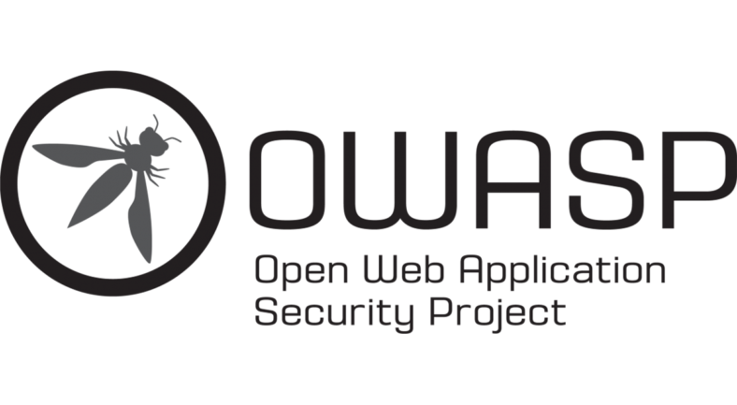
Top 10

Slide 26
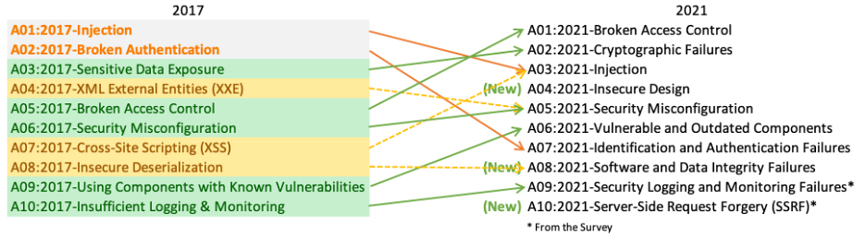

Slide 27

Use different strategies for different things
Notes:
Azure functions when on the ‘consumption’ plan can’t use network isolation. But that doesn’t mean they are not useful in your architecture.
Use consumption functions for event-based integrations where you do not have a high value database (remember RISK). Then use managed identities to secure your own APIs

Slide 28

Reduce operational overhead
Notes:
Most teams do not have the operational capacity to be proactive on security and continually reducing the risk, and often the business doesn’t realise what risks it has.
The better our defaults, and the simpler our primitives are the more likely our developers who have a growing number of responsibilities will be able to ship software securely

Slide 29


Network security is still important!
CHAOSDB
> log4shell
Notes:
BUT I think we should move towards a model where each of our services have their own network to protect the database, storage and other key data stores within that service boundary, but it has a interface. That interface MAY be a public HTTP endpoint, but it could be a message queue, a endpoint connectable via a mesh network or another type of interface.
We use zero trust principles to talk between our service boundaries and we can then limit complexity which can come from better security practices to the service boundaries which have the highest risk. Allowing lower risk applications to be built cheaper and easier on layer 2 clouds or higher level PaaS services like Azure Functions

Slide 30

The Future?

Slide 31
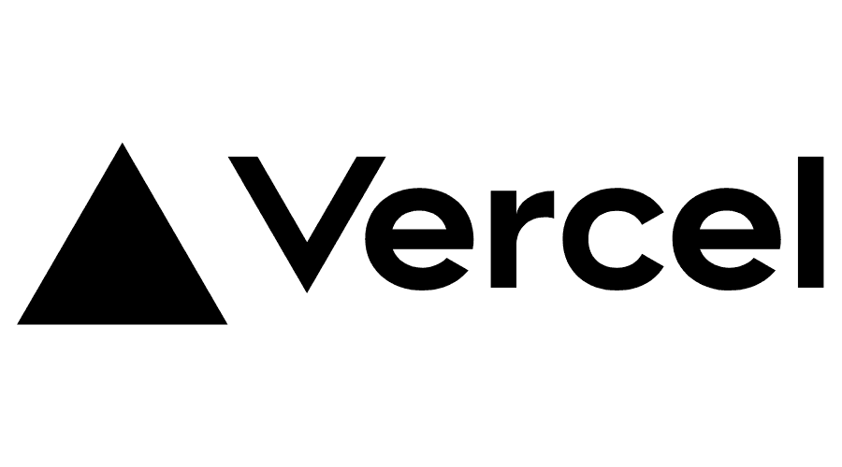

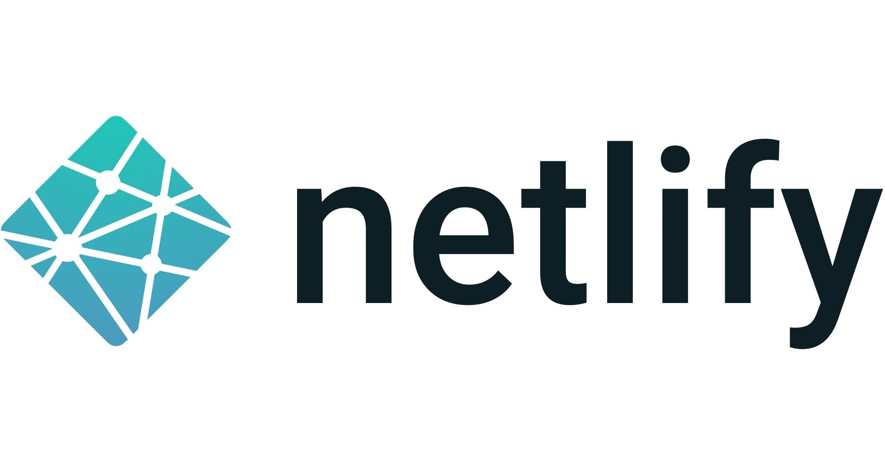
Layer 2 Clouds
Notes:
For “simple” projects, layer 2 clouds are great. They bring together all these different services so you don’t have to.
They can invest a lot in security because each improvement affects thousands of customers and so many projects.
I think there will also be software defined layer 2, which will allow you do deploy an application environment into your own cloud/subscription which then you can deploy into.

Slide 32

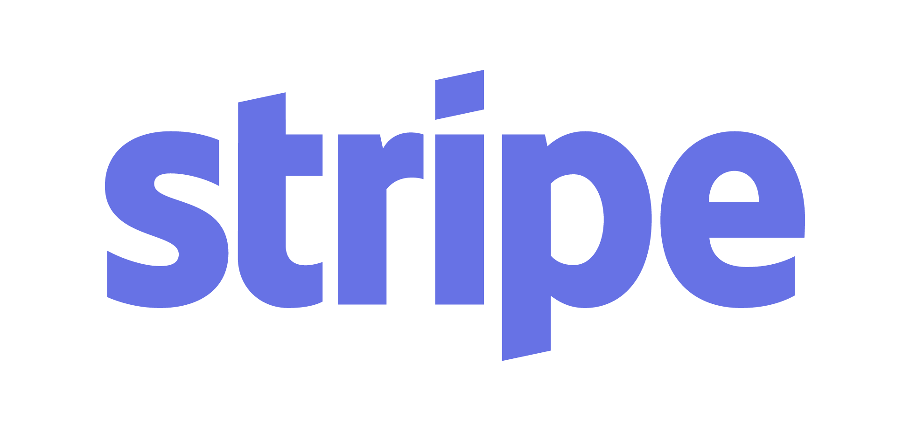
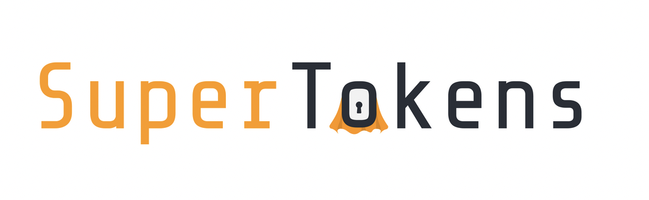
Great SaaS Products
Notes:
These are just 3 random ones I thought of. But there is *a lot* of innovation happening out there, and sometimes these products can bring a huge amount of value to smaller companies.
The trade offs from using SaaS products may not make sense for larger enterprise customers but SMB’s can reduce their risk significantly by using some of these services which are high value targets without the luxury of being able to rely on network level security so have had to invest in other ways to ensure their services stay secure

Slide 33

Secure multi cloud
Notes:
Tailscale
Nebula from slack
Native support for adding your JWT public key and configuring the access rules, extending your zero-trust model and not adding additional authentication steps (each increasing risk)

Slide 34

Self provisioning runtimes

Slide 35
import * as azure from '@pulumi/azure' const resourceGroup = new azure.core.ResourceGroup('example', { location: 'West US' }) const greeting = new azure.appservice.HttpEventSubscription('greeting', {
resourceGroup,
callback: async (context, req) => {
return {
status: 200,
body: `Hello ${req.query['name'] || 'World'}!`
}
}
}) export const url = greeting.url
const storageContainer = new azure.storage.Container("images-container", {
resourceGroupName: resourceGroup.name,
storageAccountName: storageAccount.name,
name: "images",
})
storageContainer.onBlobEvent("newImage", {
callback: async (context, blob) => {
console.log("File size: " + context.bindingData.properties.length);
},
filterSuffix: ".png",
})

Slide 36

More services like Durable Functions
Notes:
Durable functions increase the abstraction, they allow you to write code which the service then pulls apart and knows how to orchestrate the different parts

Slide 37

Take aways
Network isolation can and should still be used for security critical applications
Managed Identities are the primary way to secure cloud native services
Use PaaS services to communicate between different applications (Queues, Event Hub etc)
Access your risks by using threat modelling
Security is a Journey, you are never ‘done’
Use Policy, DevOps Practices and shifting security left to mitigate security issues early
No security cargo culting!

Slide 38
What does cloud native security look like?
JakeGinnivan
Notes:
This has been a bit of a journey through what I have been working through over the past few months, the tools I like to focus on more than others

Slide 39

Let’s continue the conversation I’m done talking ☺

